Slide 1
Understanding Pupils’ Behaviour as a Bodily Response, Not a Deliberate Choice

Slide 2

Meet Annie
Hi, Im the founder & CEO of Autism & ADHD, a multi
award winning not for profit social enterprise based in
Suffolk but working globally. ​
Annie is ADHD, and all her family and staff are
neurodivergent and has over 35 years experience of
supporting the ND community. ​
​
As well as providing a world class support service,
both pre and post diagnosis, Annie develops and
delivers training across all areas, has lectured in
universities both here in the Uk and abroad and is
involved in formal research to support change. ​
She loves going to the gym, swimming, rugby
(watching not playing lol) as well as formula 1 , and
can’t wait to see Lewis Hamilton become World
Champion again this season !!!

Slide 3

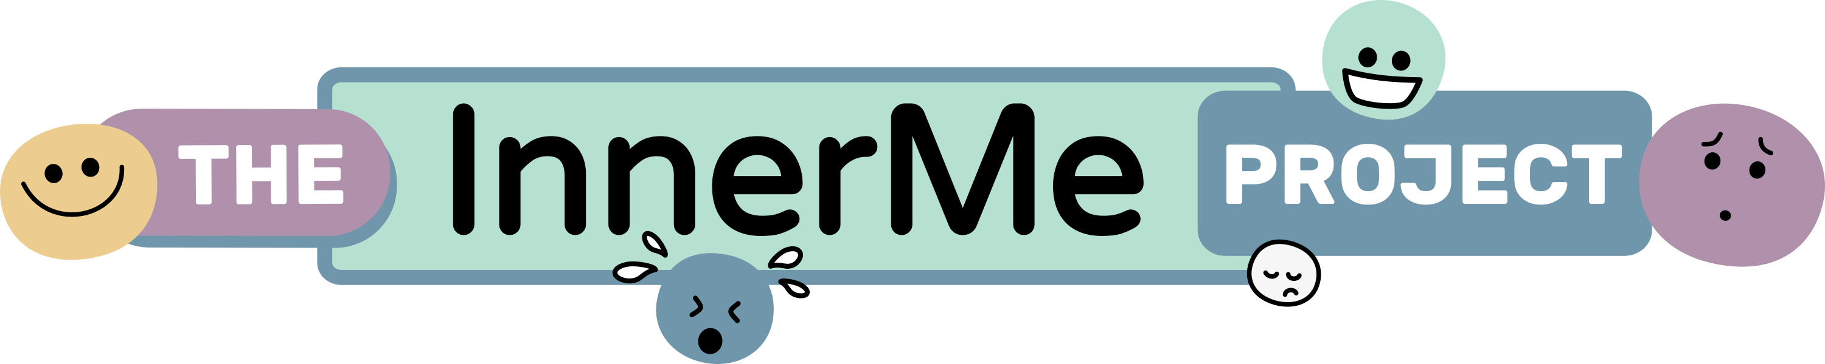
Meet Kate
Kate is a Specialist Occupational Therapist with nearly 20 years’ experience supporting children whose behaviour and needs are often misunderstood.
Through my work with families, schools, and services, she saw that many behaviour approaches focus on controlling behaviour, rather than understanding what the child’s body is communicating.
This led me to create The InnerMe Project, an approach that helps professionals and families understand behaviour through the nervous system, sensory processing, and interoception.
Kate’s mission is to help services shift:
• From compliance to connection
• From punishment to nervous system support
• From “fixing behaviour” to understanding the body behind it
Because when we understand the body first,
behaviour finally starts to make sense.

Slide 4
What if behaviour isn’t a choice?
Notes:
Why do skills disappear under stress?
Why do some children escalate faster than others?
Why does punishment rarely fix the pattern?
Key line:
We are often responding to behaviour as a decision, when it is a nervous system state.
4

Slide 5
The body drives behaviour
Interoception = body signals inside us
Sensory load fills the body all day
Stress lives in muscles, heart, breath
Poor sensory motor skills can cause fatigue, frustrations and avoidance.
A tired body cannot regulate behaviour

Slide 6
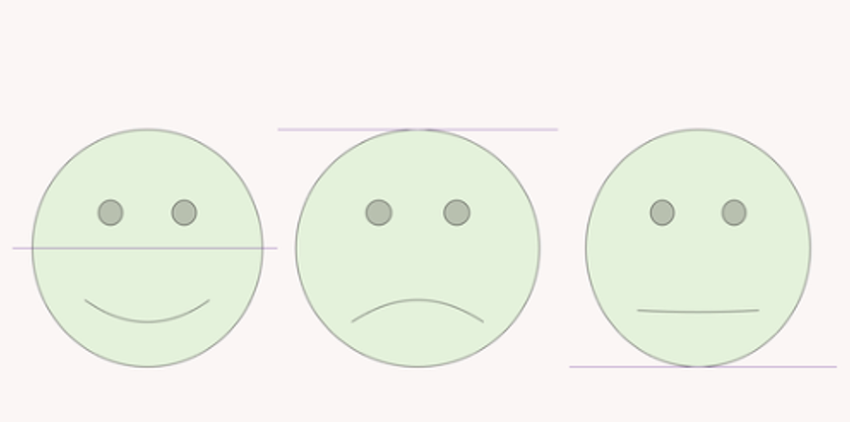
3 faces of Emotional Overwhelm

Slide 7
The 4 Pillars underneath Behaviour
Safety
Body
Brain
Behaviour
Notes:
The 4 pillars underneath behaviour
Visual stack:
Safety → Body → Brain → Behaviour
Key message:
Behaviour sits on top. The body and brain drive everything underneath.
7

Slide 8
Safety is felt in the body first.
The body is always scanning: Am I safe?
Safety is a body feeling, not a rule
When safety drops → survival takes over
Behaviour rises as protection
Notes:
Every child has an internal alarm system. The brain and body are constantly scanning the environment without the child choosing it. This is called neuroception — the body deciding if a situation feels safe, dangerous, or uncertain.
Children don’t think their way into safety.
They feel their way into it.
If the body senses threat — noise, pressure, unpredictability, social demand — the nervous system shifts into survival. That shift happens faster than thinking.
At that moment, behaviour is not about choice.
It is about protection.
If a child does not feel safe in their body, behaviour will always escalate before skills appear.
We cannot reason with a survival response.
We must restore safety first.
8

Slide 9
What is happening in the nervous system?
Shouting, swearing, snapping
→ Adrenaline surge, threat response, feeling unsafe
Leaving the class or meeting abruptly
→ Overwhelm from sensory input or emotional pressure. The body seeks escape to reduce stress.
Frequent lateness or missed deadlines
→ Overload on executive functioning. The nervous system struggles to initiate tasks when in survival mode.
Shutting down during group work or discussions
→ Social or cognitive fatigue. The nervous system conserves energy to prevent further overload.
Constant talking, interrupting, repeating
→ Anxiety, need for predictability, internal chaos
Pacing, rocking, fidgeting
→ Body trying to regulate arousal through movement
Emotional reactivity to feedback
→ Feedback is perceived as a threat. The stress response kicks in to protect, leading to emotional reactions.
Mid-term burnout or disengagement
→ Chronic stress without recovery. The nervous system becomes depleted, resulting in disengagement.
“I don’t know”, “I can’t”, “leave me alone”
→ Cognitive overload, body not ready for thinking
Exhausted, flat, disengaged
→ Burnout, depleted nervous system
Notes:
Behaviour improves when the body and brain are supported — not controlled.
Understanding reduces escalation.
Safety restores capacity.
Capacity allows skills.
9

Slide 10

Which do you focus on?
Do you meet the child where they are in the moment, or do you expect them to meet you where you want them to be?
When setting expectations, do you consider the child’s sensory needs and energy levels, or do you expect the same from them at all times?

Slide 11



What is Interoception Awareness?
Bodily Sensations
Feeling / Emotions
Action
Bodily States
Emotional States
Happy
Sad
Angry
Frustrated
Movement
Eating
Sleeping
Toileting
Notes:
Interoception is the body’s ability to notice internal signals:
hunger
thirst
tension
heartbeat
fatigue
overwhelm
Many children struggle to read or regulate these signals. They don’t always know they are overwhelmed — they just feel wrong.
Throughout the school day, sensory information piles up:
noise
movement
social effort
expectation
self-control
The body becomes overloaded long before behaviour appears.
Behaviour is often the body saying:
“I can’t carry this anymore.”
11

Slide 12
Supporting the Nervous System When School Feels Too Much
What do we mean by pacing?
Pacing is the careful adjustment of demands to match a child’s nervous system capacity.
It prevents overload and allows the brain and body to return to safety.
Without pacing, we often see:
Shutdown
School avoidance
Meltdowns
Emotional exhaustion
Masking followed by burnout
Pacing protects the nervous system from repeated overwhelm.

Slide 13
What overwhelm looks like in the body
When school demand is too high the nervous system shifts into protection:
Fight – anger, refusal, aggression
Flight – running away, avoiding school, leaving class
Freeze – shutdown, blanking, disengagement
Fawn – masking, people-pleasing, appearing “fine” then collapsing later
Behaviour is the body’s signal that the nervous system is struggling to stay safe.

Slide 14
Therapeutic Pacing in educational environments
Reducing demand before crisis
  shorter tasks
  flexible expectations
  predictable routines
Building recovery time into the day
  movement
  sensory regulation
  quiet spaces
Watching the body, not just behaviour
  breathing
  posture
  energy levels
  engagement
Responding early
  noticing rising stress
  adjusting expectations
  offering regulation support

Slide 15
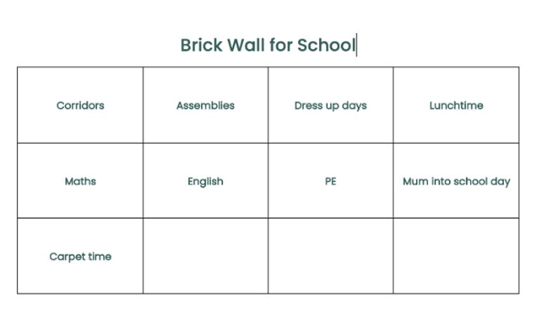

Slide 16

Sensory Layering: Supporting the Body to Stay Available for Learning
Sensory layering is the intentional use of multiple sensory supports throughout the day to help a child’s nervous system remain stable.
Rather than waiting until a child is overwhelmed, we build small sensory supports into the environment, activities, and routines so the body stays regulated.
One layer might not be enough, but together they help the body stay comfortable.
In the same way, small sensory supports layered across the day help the brain and body stay ready for learning.
Pacing adjusts demand levels.
Sensory layering supports nervous system capacity.
When we combine both approaches:
demand becomes manageable
the body remains regulated
learning becomes accessible
Notes:
Why Sensory Layering Matters
Children who experience sensory processing differences or nervous system stress are often using a huge amount of energy just to cope with the environment.
Busy classrooms contain constant sensory input:
noise
movement
visual clutter
transitions
social demands
sitting still for long periods
When this input builds faster than the nervous system can manage, the body moves into fight, flight, freeze or shutdown.
Sensory layering helps the body stay within a manageable window of regulation.
What Sensory Layering Looks Like in Practice
Instead of one big sensory break, we add small regulating supports across the day.
Examples include:
Movement Layer
short movement bursts between tasks
carrying books or equipment
wall pushes or chair push-ups
Proprioception Layer (body awareness)
resistance bands on chairs
weighted lap pads or cushions
pushing heavy doors or equipment
Environmental Layer
calm seating spaces
reduced visual clutter
headphones or sound dampening options
Attention Layer
fidget tools for hands
alternative seating such as wobble cushions
standing desks or floor seating
Regulation Layer
predictable routines
calm transitions
quiet reset spaces
16

Slide 17
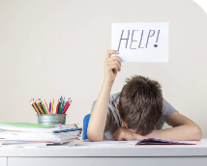
“Why does everything fall apart after school?”
Parent’s are not Imagining it
Key messages:
Children hold it together all day
Home is where the body finally feels safe
After-school behaviour is common and meaningful
Reassurance:
This isn’t poor parenting. It’s pressure releasing.

Slide 18

Behaviour is the bodies pressure valve.
If we ignore the body, behaviour gets louder.
If we support the body, behaviour softens.
Regulation is physical before it is emotional.

Slide 19
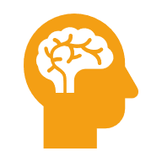



Stress Switches the Brain Into Survival Mode
The survival brain acts faster than thinking
Fight / flight / freeze are automatic
Skills disappear under stress
The brain protects before it learns
Notes:
When stress rises, the brain shifts from the thinking brain to the survival brain.
This is not misbehaviour.
This is biology.
The survival brain is designed to:
escape danger
fight threat
shut down to conserve energy
cling or comply to stay safe
When that system is active:
listening drops
memory drops
language drops
self-control drops
Not because the child won’t use skills.
Because the brain can’t access them.
19

Slide 21
Behaviour is the message, not the problem
Behaviour is communication form the nervous system.

Slide 22
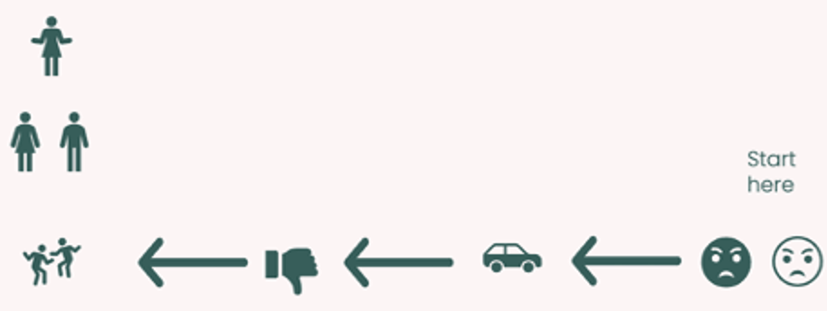

Slide 23

You can not teach a brain that is busy surviving
The brain must feel safe before it can learn.
Regulation unlocks skills.
Notes:
Behaviour is not random.
It is the visible signal of an invisible body and brain state.
When we only focus on stopping behaviour, we silence the message but keep the distress.
When we read behaviour as information, we respond to the need underneath.
A meltdown is not manipulation.
It is a nervous system flood.
A shutdown is not laziness.
It is energy collapse.
Refusal is often not defiance.
It is a body that has reached its limit.
23

Slide 24
When you view behaviour which area of dysregulation does it come under?
Sensory:
- Sensory triggers/overwhelm
Physical :
- Hunger, lack of movement, nutrient deficiency, lack of sleep
Emotional:
- Mental Health/Trauma/feeling unsafe
This will help guide your intervention.

Slide 25
We Regulate First, We Teach second
Support the Body
Calm the brain
Behaviour Changes

Slide 26
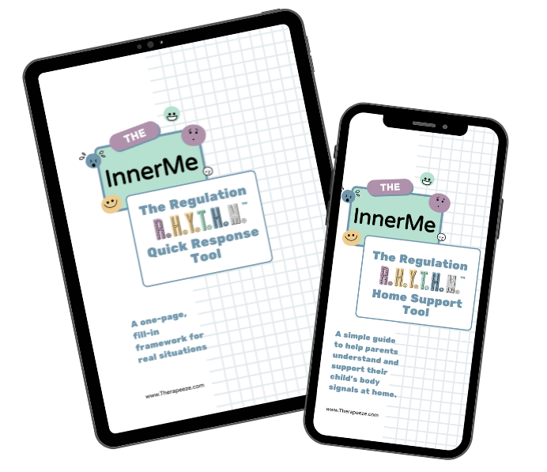

Beyond Behaviour Toolkit
Understanding the body behind behaviour helps professionals:
respond more calmly in difficult moments
reduce escalation and emotional overload
support regulation before reasoning
build stronger partnerships with families
move from behaviour management to behaviour understanding
www.innermeproject.com
Scan here

Slide 27
How you can reach us
Autism & ADHD
www.autismandadhd.org
Annie.clements@autismandadhd.org
Facebook - @autismandadhd1
If you would like Free trainings on.
’Understanding burnout “ &
‘How to heal from burnout’
please email me with the email header
‘BURNOUT VIDEOS’

